Slide 1
DLA Mentor-Protégé Program
Industry Overview
Armenthia Massey, DLA MPP Manager​
April 2025

Slide 2
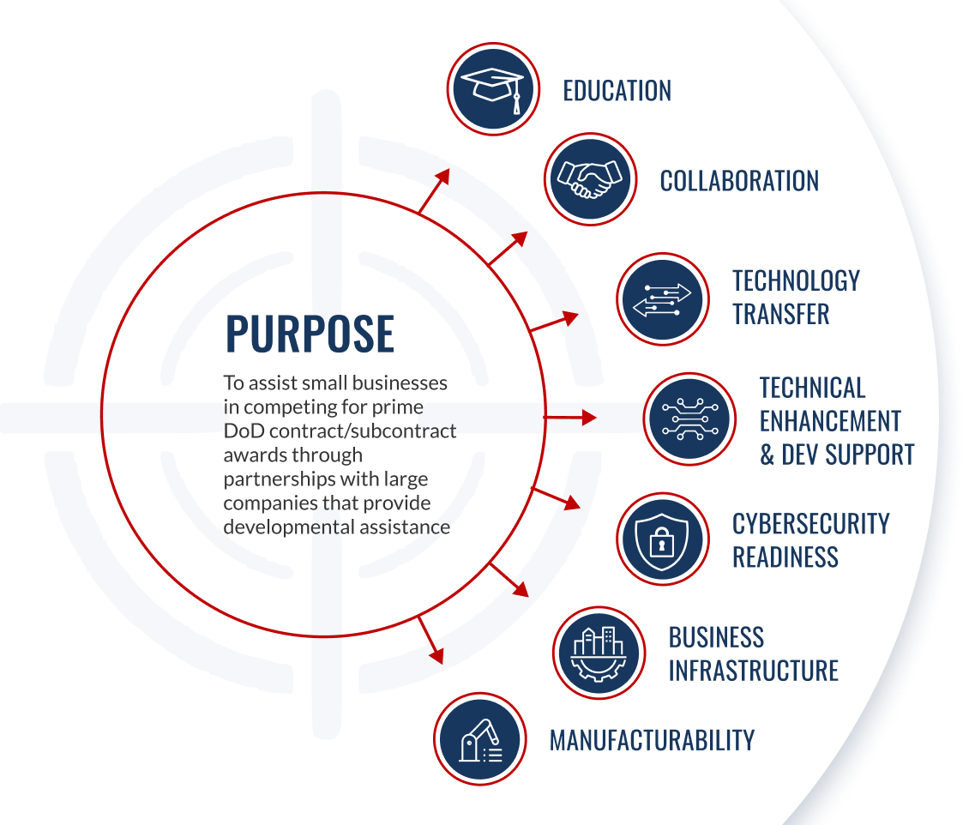

Defense Logistics Agency Office Of Small Business Programs
Mentor-Protégé Program
MENTOR PROTÉGÉ PROGRAM
Defense Logistics Agency
(10 USC 4902)
https://www.dla.mil/Small-Business/Vendor-Opportunities/
To strengthen and modernize the defense industrial base by connecting businesses new to government contracting with more experienced government contractors to provide broader and deeper capabilities to the military supply chain.

Slide 3
MPP Benefits
Mentor Benefits:
Develop business relationships with businesses capable of and/or new to government contracting
Develop a high-quality subcontracting pool
Enhance the technical capability of the protégé
Pursue new market opportunities as part of a team
Issue subcontracts to their Protégé on a non-competitive basis
Gain a source selection past performance evaluation factor
Receive cost reimbursement or subcontracting credit
Protégé Benefits:
Technology transfer
Engineering and technical training
Business infrastructure enhancement
Develop business relationship with a Prime Contractor
Expand subcontracting opportunities
Business development and planning training
Leverage technical expertise of the Mentor to bid on small business set-aside contracts
Improve competitive advantage
DoD/DLA Benefits:
Supports the warfighter
Reduce backorders
Combat obsolescence
Increase readiness levels
Brings innovative tech into established Acquisition Programs
Increase the Defense Industrial Base (DIB)
Ensures capacity & capability to support prime and subcontracting requirements
Fosters the establishment of long-term business relationships which benefit DoD, DLA, and the DIB

Slide 4
Who Can Participate?
Mentor requirements include:
Must be an approved DoD Mentor via the application process
Be eligible for the award of Federal contracts;
  Must Demonstrate:
    Is qualified to provide assistance that will contribute to the purpose of the program;
    Is of good financial health and character;
    Is not on a Federal list of debarred or suspended contractors; and
    Is an Other Than Small Business Concern, unless approved by DoD OSBP
Be capable of imparting value to a Protégé firm because of experience gained as DoD contractor or through knowledge of general business operations and government contracting, as demonstrated by evidence that such entity:
  Received DoD contracts and subcontracts equal to or greater than $25 Million during the previous FY;
  Is a Prime contractor to DoD with an active subcontracting plan; and,
  Demonstrates the capability to assist in the development of Proteges firms
  In addition, mentors must meet additional requirements outlined in DFARS Appendix I-102(a).
Protégé requirements include:
Must not be owned or managed by individuals or entities that directly or indirectly have stock options or convertible securities in the mentor firm.
In addition, protégés must meet additional statutory requirements outlined in 10 USC 4902
* Refer to DFARS Appendix I and 10 USC 4902 for additional information

Slide 5
DLA’s Approach To The MPP
The Defense Logistics Agency will take a multifaceted approach to the MPP process. The following approaches may be utilized:
Direct to Mentor/Direct to DLA:
  DLA will work with mentor directly regarding requirements where there is a sole or limited need and/or capability. (solicitation will not be published.)
Open Call:
  DLA will publish a solicitation stating specific requirements and statement of work that will be open for an extended period of time and allows for awards on a rolling basis.
Broad Agency Announcement (BAA)
  DLA will publish a solicitation in the form of a problem statement for requirements that do not have a specific or defined statement of work but pose a problem or challenge.
Published opportunities will be posted at: sam.gov/SAM/

Slide 6
MPP Agreement Types
Types of DoD Mentor-Protégé Agreements (MPAs):
Direct Reimbursement MPAs
  Allows for direct cost reimbursement of allowable costs
    Direct labor costs (for assistance by Mentor firm employees)
    Assistance provided by Authorized Subcontractor(s)
    Other costs
Credit MPAs
  Costs incurred under Credit Agreement may be applied towards SDB subcontracting goals under any Federal Agency Subcontracting plan
  Agreement is administered by DCMA
Hybrid MPAs
  Agreements start out as a Credit Agreement for the first year and then can be modified to include Reimbursable Agreement provisions for remainder of the agreement

Slide 7
Pertinent Information
DoD OSBP manages the Mentor application and Mentor approval process
  Located at: MPP Portal (osd.mil)
    Mentors are required to revalidate approval every 5 years
Mentor firms are solely responsible for selecting Protégé firms
A Protégé firm may not be a party to more than one DoD MPA at a time
There is no current limit on the number of MPAs for a Mentor
A Protégé may only participate in the DoD MPP during the 5-year period beginning on the date the Protégé enters into its first MPA
MPP contracts:
  Move America and ACC/APG (via a Cooperative Agreement) will provide contracting support for DLA MPP contracts.
  Reimbursement contracts will be established between Move America and the Mentor on behalf of DLA. However, DLA will maintain oversight of the contract.
  Credit Reimbursement and Hybrid Reimbursement contracts will be established by DCMA on behalf of DLA. However, DLA will maintain oversight of the contract.

Slide 8
MPP Forms Of Assistance
  A MPA agreement may provide for the Mentor to furnish any or all of the following types of developmental assistance:
  Assistance by Mentor personnel in:
  General business management, including organizational management, financial management, and personnel management, marketing, and overall business planning;
  Engineering and technical matters such as production, inventory control, manufacturing, test and evaluation, and quality assurance; and
  Any other assistance designed to develop the capabilities of the protege firm to:
    Participate in DoD, Federal, and/or commercial contracts and subcontracts; and
  Increase subcontracting opportunities in industry categories where eligible protégés or other firms are not dominant in the company’s vendor base.
  Assistance in understanding contract regulations of the Federal Government and DoD (FAR and DFARS) – mandatory (FY23 NDAA highlighted this);
  Award of subcontracts to the Protégé firm under DoD contracts or other contracts on a noncompetitive basis;
  Payment of progress payments for performance of the Protege firm under such a subcontract in amounts as provided for in the subcontract;
  Advance payments under such subcontracts;
  Loans; and
  Assistance obtained by the Mentor for the Protégé from one or more Authorized Subcontractor.

Slide 9
MPP Authorized Subcontractors
Authorized Subcontractors: businesses and organizations that perform work for a Federal contractor that is related to and necessary for the performance of a Federal contract.
Historically Black Colleges and Universities (HBCUs)
Minority Serving Institutions (MSIs)
Small Business Development Centers (SBDCs)
Apex Accelerators (Formerly PTACs)
Manufacturing Extension Partnerships (MEPs)
Women Business Centers (WBCs)
Manufacturing Innovation Institutes (MIIs)
*Note – DLA requires the use of Authorized Subcontractors at nlt 5% of the total agreement cost.**

Slide 10


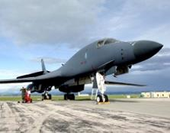
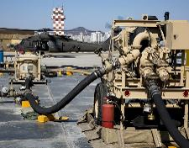
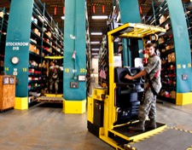
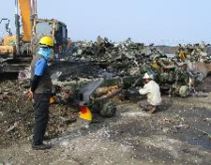
DLA MPP Areas Of Focus
SIX MAJOR BUSINESS UNITS
TROOP SUPPORT
LAND AND MARITIME
AVIATION
ENERGY
DISTRIBUTION
DISPOSITION SERVICES
PHILADELPHIA, PA
COLUMBUS,
OH
PHILADELPHIA, PA
COLUMBUS,
OH
RICHMOND,
VA
FORT BELVOIR, VA
RICHMOND,
VA
NEW CUMBERLAND, PA
BATTLE CREEK, MI
No Bid Items
Hose Assemblies and Couplings
Cable Assemblies
Motor Vehicle Parts
Legacy Aircraft
Obsolete Items
Backordered Items
C-130
H-1
Bulk Petroleum Products
Supply Chain Services
Global Storage
Distribution Solutions
Clothing & Textiles
    - Coveralls
    - Individual
    Equipment
    - Gloves
    Construction & Equipment
    - Containers
    - Metals
No Bid Items
Hose Assemblies and Couplings
Cable Assemblies
Motor Vehicle Parts
Legacy Aircraft
Obsolete Items
Backordered Items
C-130
H-1
Hazardous Waste

Slide 11
Steps In Participating
8
Ask Questions
Continual and consistent evaluation of the work effort.
7
Reporting and DCMA Review Requirements
Semi-annual reports, annual DCMA performance reviews and protégé five-year-out reports are required for each DoD MPP agreement.
6
Start Agreement
Credit agreements start on the date they are approved. Directly reimbursed agreements start on the date funds are obligated to the contract.
5
Submit Agreement Proposal
Developmental assistance should align with the protégé's strategic vision.
4
Develop Pitch Presentation
Present the initial details of the agreement to the potential sponsor/Major Subordinate Command.
3
Develop Agreement
An assessment of the needs of a protégé, which includes measurable milestones, is recommended prior to the development of an agreement.
2
Determine the Type of Agreement
Direct Reimbursement, Credit, or Hybrid
1
Establish a Counterpart
Mentors and Protégés are solely responsible for finding their counterpart.

Slide 12
Pitch Presentation Briefing Requirements
The Briefing should include the MSC Evaluation Team about developing the MPA. The preparation of this briefing should be a broad representation of the proposed concept and objectives of the MPA. DLA’s decision and feedback will be provided no later than one week after the briefing. The briefing should include at least the following:
  Background of the Protégé including cage, NAICS, and other pertinent information
  Background on the Mentor’s experience in mentoring other formal MPAs
  Type of Agreement (Reimbursement, Credit (DCMA), or Hybrid)
  Identified concept and objectives of the proposed MPA
  Primary NAICS Code(s) that will be supported
  Proposed Mentor technical (nlt 50%) and administrative transfers
  The use of Authorized Subcontractors (nlt 5% of the total yearly agreement cost)
  Benefits to the Mentor, Protégé and DLA of the proposed agreement
  Rough Order Magnitude (ROM) Cost Estimate Worksheet (*any agreement cost over $750K per year requires additional justification)
  Estimated time of completion
  Determine if the Protégé Pilot Initiative (PPI) application will be submitted
  Rationale of why the MSC should sponsor the agreement

Slide 13
MPP References and Links
DoD Mentor-Protégé Program Policy and Regulations:
  DoD Mentor Protégé Program
    (https://business.defense.gov/Programs/Mentor-Protege-Program/)
  Defense Federal Acquisition Regulation Supplement (DFARS)
    (https://www.acq.osd.mil/dpap/dars/dfarspgi/current/index.html)
  DFARS Appendix I
    (https://www.acq.osd.mil/dpap/dars/dfars/html/current/appendix_i.htm)
  DFARS Subpart 219_71
    (https://www.acq.osd.mil/dpap/dars/dfars/html/current/219_71.htm)
  DoD Mentor-Protégé Portal
  MPP Portal (osd.mil)
    (https://mpp.acq.osd.mil/mpp/#/)
  DLA Mentor-Protégé Program Details
  Small Business (dla.mil)
    (https://dla.mil/Small-Business/)

Slide 14
DLA MPP Contact Information
DLA MPP Contact information:
  Program Manager
  Ms. Armenthia “Mint” Massey
    Email: DLAMPP@dla.mil
  Contract Support
  Mr. Cameron Burton
  Email: DLAMPP@dla.mil

